Slide 1
ALGORITHMS Algorithm Analysis
Asma Fariha
Lecturer, Department of Computer Science
American International University-Bangladesh (AIUB)
asma.fariha@aiub.edu

Slide 2
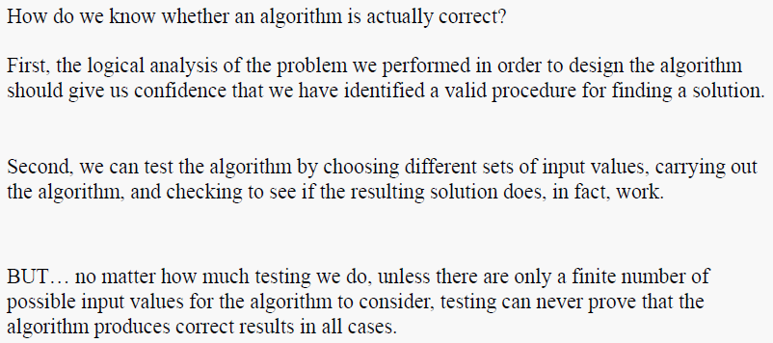
Testing Correctness

Slide 3
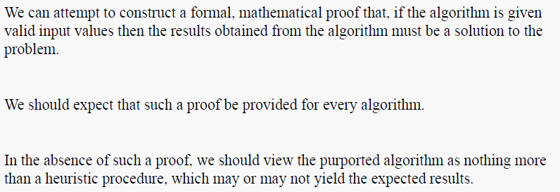
Proving Correctness

Slide 4
Overall Picture
Using a computer to help solve
problems.
Precisely specify the problem.
Designing programs
Architecture → data structure
Technique → algorithms
Writing programs
Verifying (testing) programs
Data Structure and Algorithm Design Goals
Correctness
Efficiency
Implementation Goals
Adaptability
Reusability
Robustness

Slide 5
How to Develop an Algorithm?
Precisely define the problem.
Precisely specify the input and output.
Consider all cases.
Come up with a simple plan to solve the problem at hand.
The plan is language independent.
The precise problem specification influences the plan.
Turn the plan into an implementation
The problem representation (data structure) influences the implementation.

Slide 6
Algorithm Analysis

Slide 7
Analysis of Algorithms
An algorithm is a finite set of precise instructions for performing a computation or for solving a problem.
What is the goal of analysis of algorithms?
To compare algorithms mainly in terms of running time but also in terms of other factors (e.g., memory requirements, programmer's effort etc.)
What do we mean by running time analysis?
Determine how running time increases as the size of the problem increases.

Slide 8
Input Size
Input size (number of elements in the input)
size of an array
polynomial degree
# of elements in a matrix
# of bits in the binary representation of the input
vertices and edges in a graph

Slide 9
Types of Analysis
Worst case
Provides an upper bound on running time
An absolute guarantee that the algorithm would not run longer, no matter what the inputs are
Best case
Provides a lower bound on running time
Input is the one for which the algorithm runs the fastest
Average case
Provides a prediction about the running time
Assumes that the input is random

Slide 10
…Best/ Worst/ Average Case
For inputs of all sizes:
worst-case
6n
average-case
5n
best-case
Running time
4n
3n
2n
1n
1 2 3 4 5 6 7 8 9 10 11 12 …..
Input instance size

Slide 11
How do we compare algorithms?
We need to define a number of objective measures.
(1) Compare execution times?
Not good: times are specific to a particular computer !!
(2) Count the number of statements executed?
Not good: number of statements vary with the programming language as well as the style of the individual programmer.

Slide 12
Ideal Solution
Express running time as a function of the input
size n (i.e., f(n)).
Compare different functions corresponding to running times.
Such an analysis is independent of machine time, programming style, etc.

Slide 13
The RAM model
Machine-independent algorithm design depends upon a hypothetical computer called the Random Access Machine or RAM.
In computer science, random-access machine (RAM) is an abstract machine
The RAM model:
Each “simple” operation (+, *, -, =, if, call) takes exactly 1 time step
Loops and subroutines are not considered simple operations. Instead, they are the composition of many single-step operations. It makes no sense for “sort” to be a single-step operation, since sorting 1,000,000 items will take much longer than sorting 10 items. The time it takes to run through a loop or execute a subprogram depends upon the number of loop iterations or the specific nature of the subprogram.
Each memory access takes exactly one time step, and we have as much memory as we need. The RAM model takes no notice of whether an item is in cache or on the disk, which simplifies the analysis.

Slide 14
Example
Associate a "cost" with each statement.
Find the "total cost“ by finding the total number of times each statement is executed.
Algorithm 1 Algorithm 2
Cost Cost
arr[0] = 0; c₁ for(i=0; i<N; i++) c₂
arr[1] = 0; c₁ arr[i] = 0; c₁
arr[2] = 0; c₁
... ...
arr[N-1] = 0; c₁
----------- -------------
c₁+c₁+...+c₁ = c₁ x N (N+1) x c₂ + N x c₁ = (c₂ + c₁) x N + c₂

Slide 15
Another Example
Algorithm 3 Cost
sum = 0; c₁
for(i=0; i<N; i++) c₂
for(j=0; j<N; j++) c₂
sum += arr[i][j]; c₃
------------
c₁ + c₂ x (N+1) + c₂ x N x (N+1) + c₃ x N²

Slide 16
Asymptotic Analysis
To compare two algorithms with running times f(n) and g(n), we need a rough measure that characterizes how fast each function grows.
Hint: use rate of growth
Compare functions in the limit, that is, asymptotically!
(i.e., for large values of n)

Slide 17
Rate of Growth
Consider the example of buying elephants and goldfish:
Cost: cost_of_elephants + cost_of_goldfish
Cost ~ cost_of_elephants (approximation)
The low order terms in a function are relatively insignificant for large n
n⁴ + 100n² + 10n + 50 ~ n⁴
i.e., we say that n⁴ + 100n² + 10n + 50 and n⁴ have the same rate of growth

Slide 18
Asymptotic Notation
The “big-Oh” O-Notation
asymptotic upper bound
f(n) = O(g(n)), if there exists constants c>0 and n₀>0, s.t. f(n) ≤ c g(n) for n ≥ n₀
f(n) and g(n) are functions
over non- negative integers
Used for worst-case analysis
g(n) is an asymptotic upper bound for f(n)
Running Time
Input Size

Slide 19
...Asymptotic Notation
The “big-Omega” Ω−Notation
asymptotic lower bound
f(n) = Ω(g(n)) if there exists constants c>0 and n₀>0, s.t. c g(n) ≤ f(n) for n ≥ n₀
Used to describe best-case running times or lower bounds of algorithmic problems.
g(n) is an asymptotic lower bound for f(n)
Running Time
Input Size

Slide 20
...Asymptotic Notation
The “big-Theta” Θ−Notation
asymptoticly tight bound
f(n) = Θ(g(n)) if there exists constants c₁>0, c₂>0, and n₀>0, s.t. for n ≥ n₀
c₁ g(n) ≤ f(n) ≤ c₂ g(n)
g(n) is an asymptotic tight bound for f(n)
Running Time
Input Size

Slide 21
Big-O Notation
We say f_{A}(n)=30n+8 is order n, or O (n) It is, at most, roughly proportional to n.
f_{B}(n)=n²+1 is order n², or O(n²). It is, at most, roughly proportional to n².
In general, any O(n²) function is faster- growing than any O(n) function.

Slide 22
Visualizing Orders of Growth
On a graph, as you go to the right, a faster growing function eventually becomes larger...
f_{A}(n)=30n+8
Value of function →
f_{B}(n)=n²+1
Increasing n →

Slide 23
More Examples …
n⁴ + 100n² + 10n + 50 is O(n⁴)
10n³ + 2n² is O(n³)
n³ - n² is O(n³)
constants
10 is O(1)
1273 is O(1)

Slide 24
Back to Our Example
Algorithm 1 Algorithm 2
Cost Cost
arr[0] = 0; c₁ for(i=0; i<N; i++) c₂
arr[1] = 0; c₁ arr[i] = 0; c₁
arr[2] = 0; c₁
...
arr[N-1] = 0; c₁
----------- -------------
c₁+c₁+...+c₁ = c₁ x N (N+1) x c₂ + N x c₁ =
(c₂ + c₁) x N + c₂
Both algorithms are of the same order: O(N)

Slide 25
Example (cont’d)
Algorithm 3 Cost
sum = 0; c₁
for(i=0; i<N; i++) c₂
for(j=0; j<N; j++) c₂
sum += arr[i][j]; c₃
------------
c₁ + c₂ x (N+1) + c₂ x N x (N+1) + c₃ x N² = O(N²)

Slide 26
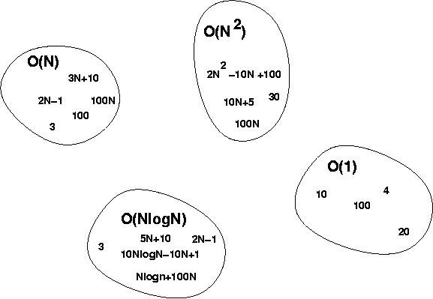
Big-O Visualization
O(g(n)) is the set of functions with smaller or same order of growth as g(n)

Slide 27
More Examples
Show that 30n+8 is O(n).
Show ∃c,n₀: 30n+8 ≤ cn, ∀n>n₀ .
Let c=31, n₀=8. Assume n>n₀=8. Then cn = 31n = 30n + n > 30n+8, so 30n+8 < cn.

Slide 28
Big-O example, graphically
Note 30n+8 isn’t less than n anywhere (n>0).
It isn’t even less than 31n everywhere.
But it is less than 31n everywhere to the right of n=8.
cn = 31n
30n+8
30n+8 ∈O(n)
Value of function →
n
n>n₀=8 →
Increasing n →

Slide 29
No Uniqueness
There is no unique set of values for n₀ and c in proving the asymptotic bounds
Prove that 100n + 5 = O(n²)
100n + 5 ≤ 100n + n = 101n ≤ 101n²
for all n ≥ 5
n₀ = 5 and c = 101 is a solution
100n + 5 ≤ 100n + 5n = 105n ≤ 105n² for all n ≥ 1
n₀ = 1 and c = 105 is also a solution
Must find SOME constants c and n₀ that satisfy the asymptotic notation relation

Slide 30
Relations Between Different Sets
Subset relations between order-of-growth sets.
R→R
O( f )
Ω( f )
• f
Θ( f )

Slide 31
Practice exercise from CLRS book

Slide 32
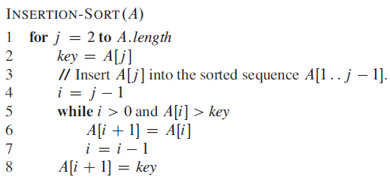
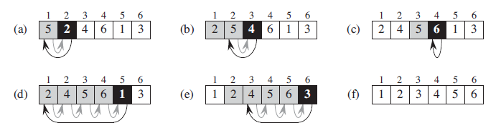
Insertion Sort

Slide 33
Analysis of Insertion Sort
Time to compute the running time as a function of the input size (exact analysis).
for j := 2 to n do
key := A[j]
// Insert A[j] into A[1..j-1]
i := j-1
while i>0 and A[i]>key do
A[i+1]:=A[i]
i--
A[i+1]:=key
cost c₁
c₂
0
c₃
c₄
c₅
c₆
c₇
times n n-1 n-1 n-1 n-1

Slide 34
…Analysis of Insertion Sort
The running time of an algorithm is the sum of the running times of each statement.
A statement with cost c that is executed n times contributes c*n to the running time.
The total running time T(n) of insertion sort is
T(n)= c₁*n + c₂(n-1) + c₃(n-1) + c₄ + c₅ + c₆
+ c₇ (n-1)

Slide 35
…Analysis of Insertion Sort
Often the performance depends on the details of the input (not only the length n).
This is modeled by t_{j.}
In the case of insertion sort the time t_{j} depends on the original sorting of the input array.

Slide 36
Performance Analysis
Performance often draws the line between what is feasible and what is impossible.
Often it is sufficient to count the number of iterations of the core (innermost) part.
No distinction between comparisons, assignments, etc (that means roughly the same cost for all of them).
Gives precise enough results.
In some cases the cost of selected operations dominates all other costs.
Disk I/O versus RAM operations.
Database systems.

Slide 37
Best/ Worst/ Average Case
Best case: works fast on some input.
Worst case: (usually) maximum time of algorithm on any input of size.
Average case: (sometimes) expected time of algorithm over all inputs of size. Need assumption of statistical distribution of inputs.
Analyzing insertion sort’s
Best case: elements already sorted, t_{j}=1, running time ≈ (n-1), i.e., linear time.
Worst case: elements are sorted in inverse order, t_{j} = j-1, running time ≈ (n²-n)/2 , i.e., quadratic time.
Average case: t_{j} = j / 2, running time ≈ (n²+n-2)/4 , i.e., quadratic time.

Slide 38
…Best/ Worst/ Average Case
Worst case is usually used:
It is an upper-bound.
In certain application domains (e.g., air traffic control, surgery) knowing the worst-case time complexity is of crucial importance.
For some algorithms worst case occurs fairly often
The average case is often as bad as the worst case.
Finding the average case can be very difficult.

Slide 39
Asymptotic Analysis
Goal: to simplify the analysis of the running time by getting rid of details, which are affected by specific implementation and hardware
rounding of numbers: 1,000,001 ≈ 1,000,000
rounding of functions: 3n² ≈ n²
Capturing the essence: how the running time of an algorithm increases with the size of the input in the limit.
Asymptotically more efficient algorithms are best for all but small inputs

Slide 40
...Asymptotic Analysis
Simple Rule: Drop lower order terms and constant factors.
50 n log n is O(n log n)
7n - 3 is O(n)
8n² log n + 5n² + n is O(n² log n)
Note: Although (50 n log n) is O(n⁵), it is expected that an approximation is of the smallest possible order.

Slide 41
Growth Rates of Functions
Data | k=2 | log n | n | n log n | n² | n⁵ | 5^{n}
1 | 2 | 0 | 1 | 0 | 1 | 1 | 5
2 | 2 | 1 | 2 | 2 | 4 | 32 | 25
3 | 2 | 1.58 | 3 | 4.75 | 9 | 243 | 125
4 | 2 | 2 | 4 | 8 | 16 | 1024 | 625
5 | 2 | 2.32 | 5 | 11.61 | 25 | 3125 | 3125
6 | 2 | 2.58 | 6 | 15.51 | 36 | 7776 | 15625
7 | 2 | 2.80 | 7 | 19.65 | 49 | 16807 | 78125
8 | 2 | 3 | 8 | 24 | 64 | 32768 | 390625
9 | 2 | 3.17 | 9 | 28.53 | 81 | 59049 | 1953125
10 | 2 | 3.32 | 10 | 33.22 | 100 | 100000 | 9765625

Slide 42
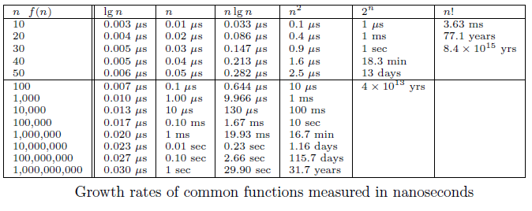
Growth Rates and Dominance Relations

Slide 43
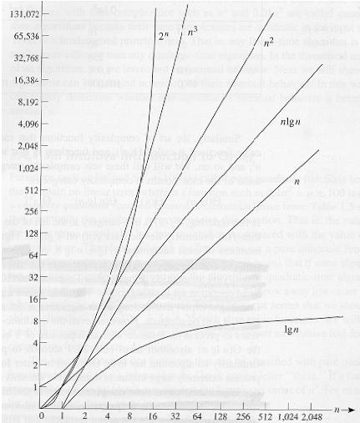
Common orders of magnitude

